Slide 1

Health Disparities Research
Module 4
Health outcome modeling
Session 3

Slide 2
Session 3 overview
Epidemiology study designs
Linear regression
Logistic regression
Application to health disparities
Examples
Ethics

Slide 3
Epidemiology study designs

Slide 4
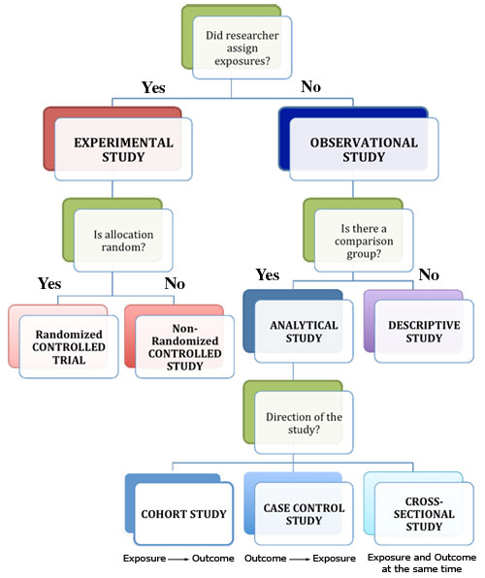
Epidemiology study designs
Image: https://cisncancer.org/research/how_cancer_is_studied/epidemiological/study_types.html

Slide 5
Randomized control trials
Randomized control trial (RCT) – participants are randomly assigned to treatment and control arms of trial
Random assignment – controls for known and unknown differences among participants that may influence outcome
Blinded – participants and experimenters blinded to assignment, mitigates bias
Gold standard for causal inference
May not be ethical (smoking) or feasible (disparities)
Race and ethnicity can not be randomly assigned

Slide 6
Health disparities: observational studies
Health disparities research often (almost always) relies on observational study designs
Cohort study – participants who have been, are, or may be exposed or not exposed to a disease risk factor
Prospective – follow from initiation of study, track outcomes
Retrospective – go back in time to identify participants, follow up to present
Most reliable type of observational study
Temporal sequence of exposure -> outcome supports causal inference
Disadvantage – case and control may not be same in all aspects, selection bias

Slide 7
Health disparities: observational studies
Case-control study – study of participants with (cases) and without (controls) disease
Identify cases and (closely) matched controls
Subsequently examine (historical) risk factors to identify exposures more commonly found in cases
Considered efficient in terms of time, money, effort
Allows for study of rare diseases
Can consider multiple risk factors at once
Good for disease outbreaks
Suffers from same selection bias disadvantage
Also recall bias, whereby cases more likely to report exposures

Slide 8
Health disparities: observational studies
Cross-sectional study – both exposure and outcome ascertained at the same time
Temporal sequence often impossible to work out
Useful in health disparities research, when assessing relative risk of outcome between race/ethnicity groups, since these are socially ascribed status that precede outcome and do not change over time
Useful in genetic epidemiology because genetic exposures precede the outcome and can not change over time

Slide 9
Warning! observational studies
Correlation (association) is not causation
Results of observational studies should be interpreted with care
Causal inference using observational data is big area of study (we will touch lightly on this)

Slide 10
Linear regression
Review based on: https://statsandr.com/blog/multiple-linear-regression-made-simple/

Slide 11
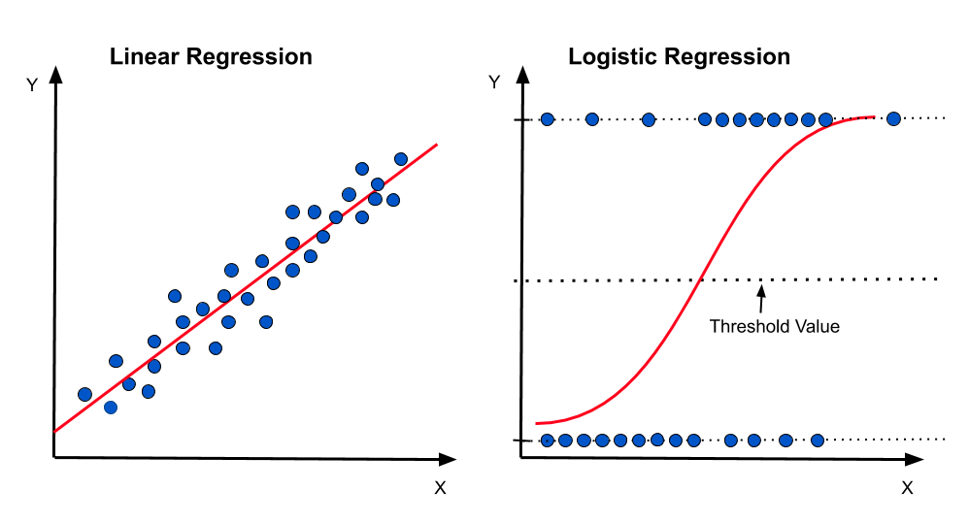
Linear regression
Regression: model the relationship between two or more variables
Estimate the relationship between a quantitative continuous dependent variable (outcome) and one or more independent variables (predictor) of any type
dependent variable (outcome)
independent variable (predictor)
Image: https://medium.com/@praveenraj.gowd

Slide 12
Linear regression
Simple linear regression: evaluate the linear relationship between two quantitative variables
Multiple linear regression: evaluate the linear relationships between a quantitative outcome variable and two or more predictor variables (quantitative or qualitative)

Slide 13
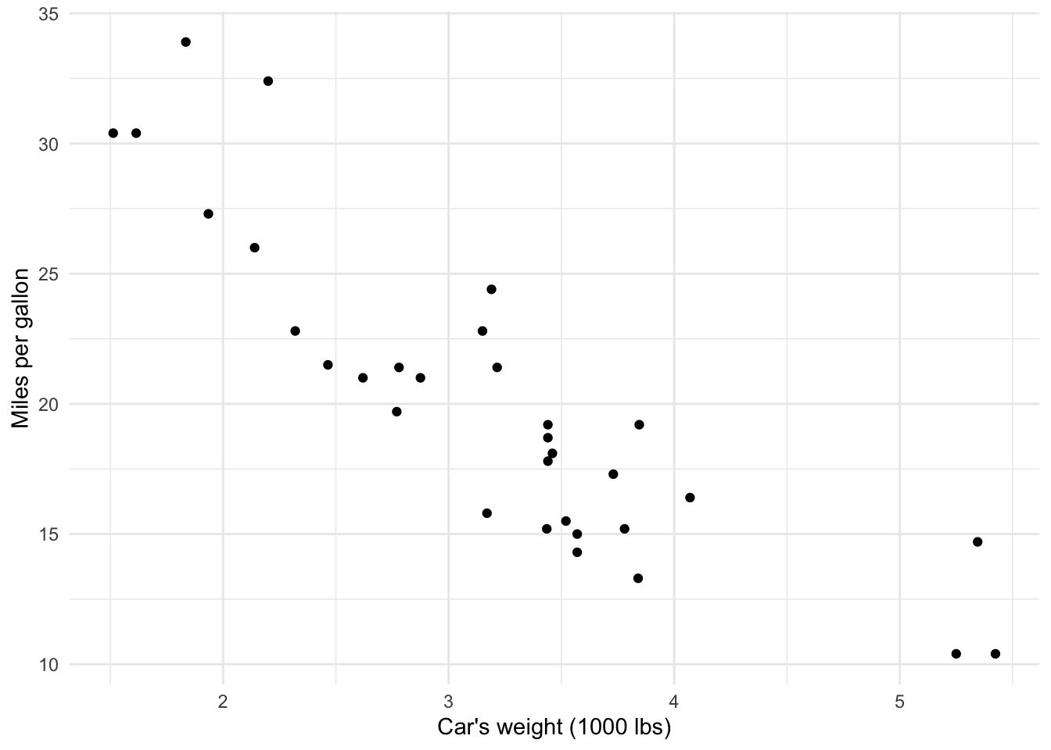
Simple linear regression: basic idea
mtcars
Data you wish to relate
y-axis – dependent variable (outcome)
x-axis – independent variable (predictor)

Slide 14
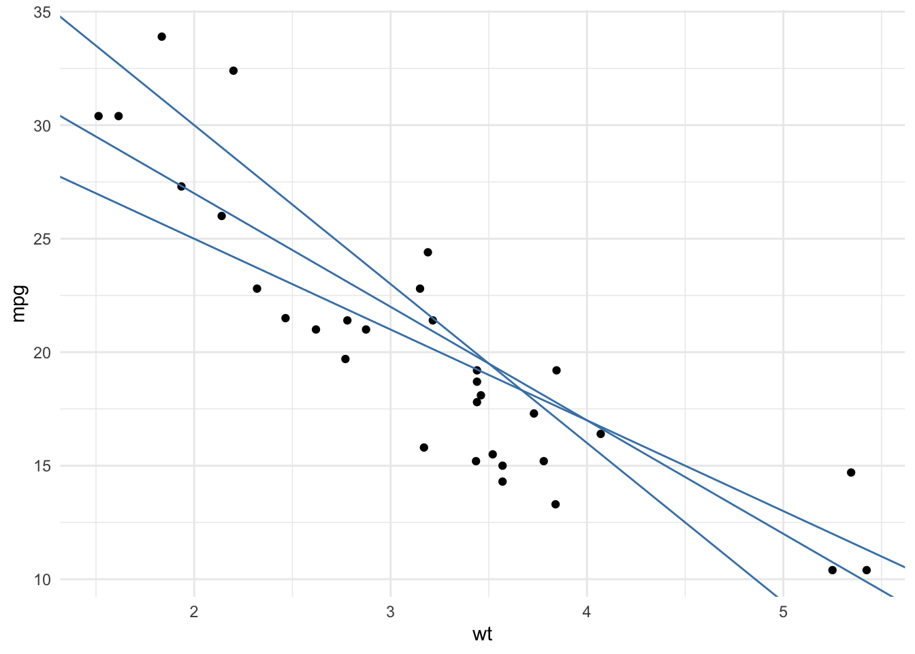
Simple linear regression: basic idea
Find the line that best fits the data

Slide 15
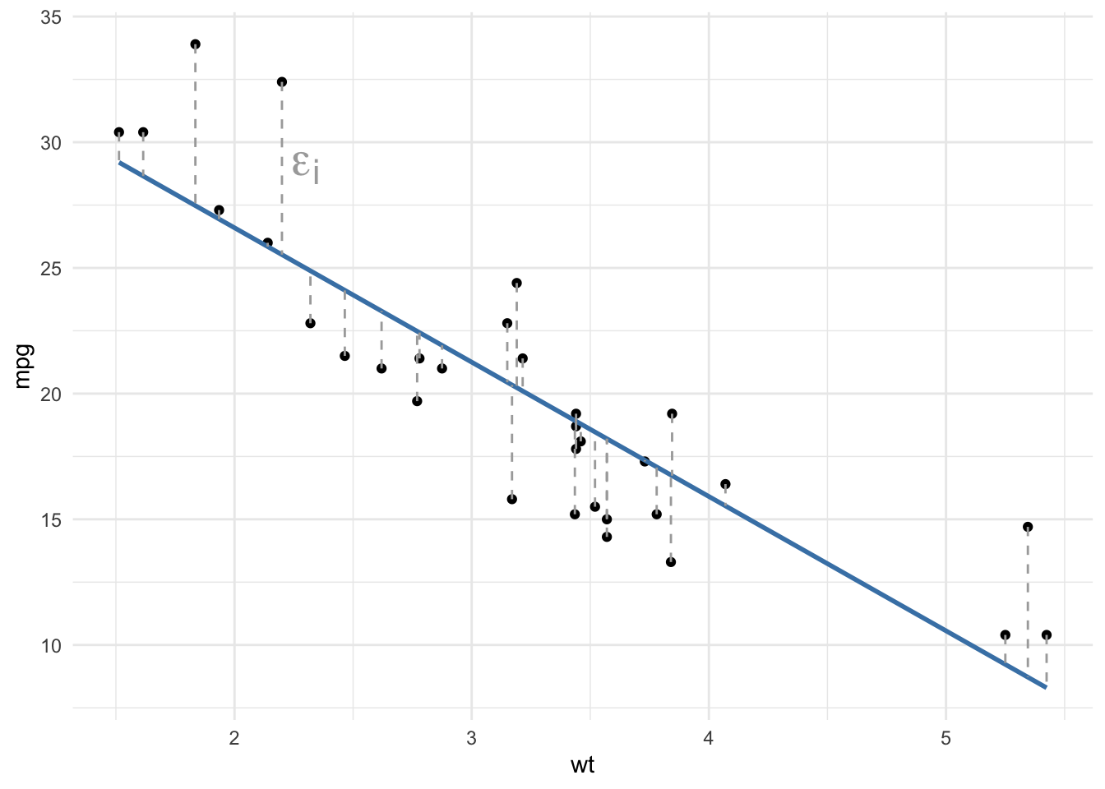
Simple linear regression: residuals
Distances between observed points and fitted line
Ordinary least squares – best fit line minimizes these distances
Sum of squared distances

Slide 16
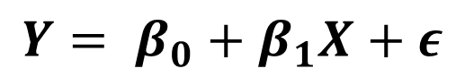
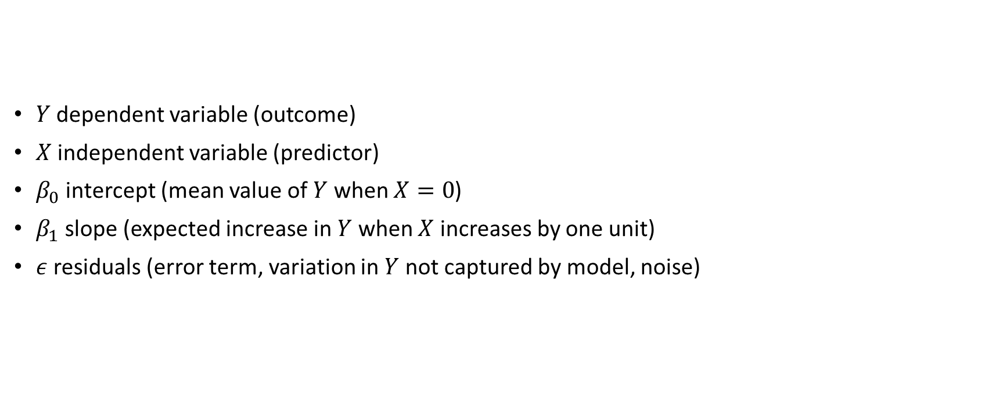
Simple linear regression model
$$Y= β_{0}+β_{1}X+ε$$
$Y$ dependent variable (outcome)
$X$ independent variable (predictor)
$β_{0}$ intercept (mean value of $Y$ when $X=0$)
$β_{1}$ slope (expected increase in $Y$ when $X$ increases by one unit)
$ε$ residuals (error term, variation in $Y$ not captured by model, noise)

Slide 17
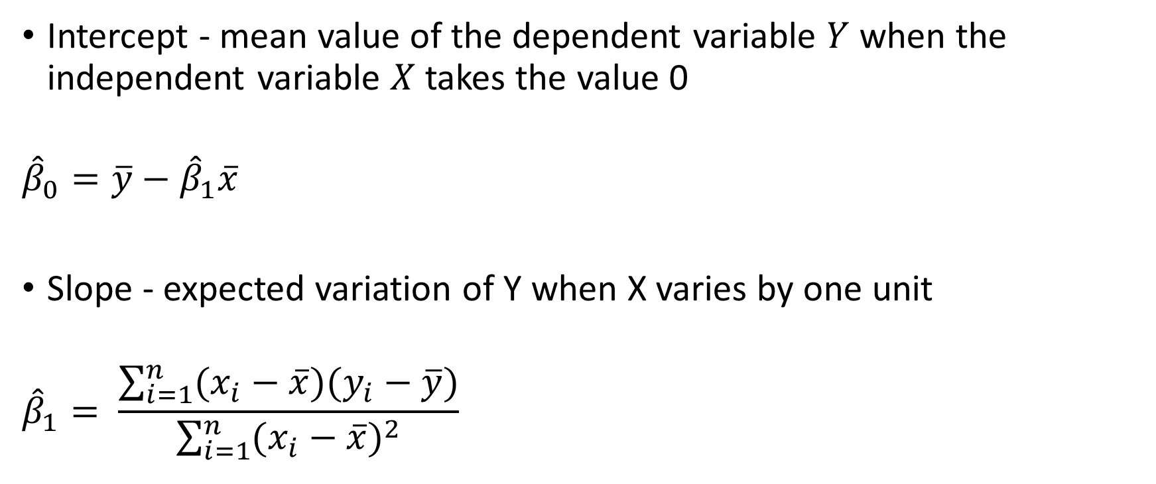
Simple linear regression model parameters
Intercept - mean value of the dependent variable $Y$ when the independent variable $X$ takes the value 0
$${\hat{β}}_{0}=\overline{y}−{\hat{β}}_{1}\overline{x}$$
Slope - expected variation of Y when X varies by one unit
$${\hat{β}}_{1}= \frac{\sum_{i=1}^{n}{(x_{i}−\overline{x})(y_{i}−\overline{y})}}{\sum_{i=1}^{n}{{(x_{i}−\overline{x})}^{2}}}$$

Slide 18
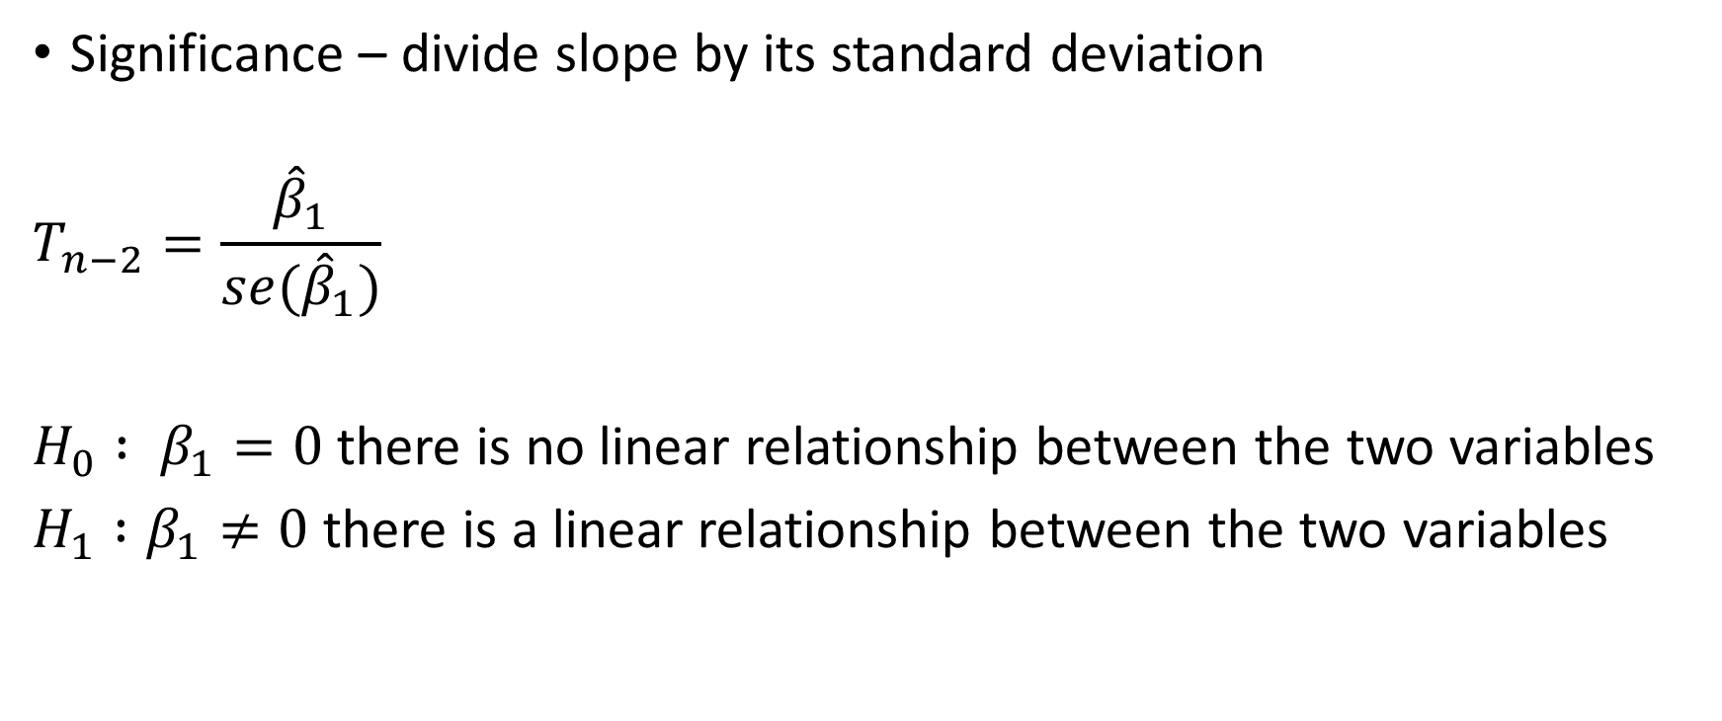
Simple linear regression model parameter significance
Significance – divide slope by its standard deviation
$$T_{n−2}=\frac{{\hat{β}}_{1}}{se({\hat{β}}_{1})}$$
$H_{0} : β_{1}=0$ there is no linear relationship between the two variables
$H_{1} :β_{1}≠0$ there is a linear relationship between the two variables

Slide 19
Simple linear regression assumptions (LINE)
Linearity: The relationship between the two variables should be linear (at least roughly).
Independence: Observations must be independent. If the data come from different individuals or experimental units, they are usually independent.
Normality of residuals: For small sample sizes, residuals should follow a normal distribution. For large sample sizes, confidence intervals and tests on the coefficients are (approximately) valid whether the error follows a normal distribution or not.
Homoscedasticity of the residuals: The variance of the errors should be constant. There is a lack of homoscedasticity when the dispersion of the residuals increases with the predicted values (fitted values).

Slide 20
Multiple linear regression
Multiple linear regression: evaluate the linear relationships between a quantitative outcome variable and two or more predictor variables (quantitative or qualitative)*
*Used most often. Evaluate the relationship of two variables controlling for the effect of other variables.
**For health disparities research, effect of race/ethnicity holding other variables constant

Slide 21
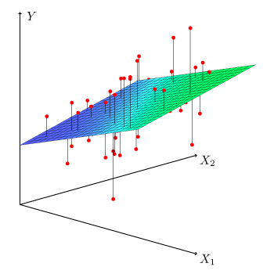
Multiple linear regression: basic idea
Find the plane that best fits the data
Generalization of simple linear regression principle

Slide 22
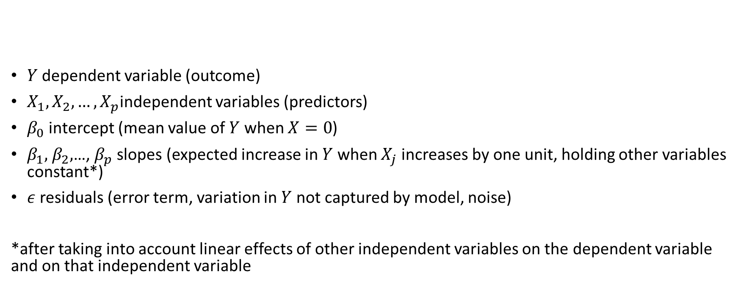
Multiple linear regression model
$$Y= β_{0}+β_{1}X_{1}+β_{2}X_{2}+…+β_{p}X_{p}+ε$$
$Y$ dependent variable (outcome)
$X_{1},X_{2},…,X_{p}$independent variables (predictors)
$β_{0}$ intercept (mean value of $Y$ when $X=0$)
$β_{1},$ $β_{2},$…, $β_{p}$ slopes (expected increase in $Y$ when $X_{j}$ increases by one unit, holding other variables constant*)
$ε$ residuals (error term, variation in $Y$ not captured by model, noise)
*after taking into account linear effects of other independent variables on the dependent variable and on that independent variable
explanatory variables
covariables
covariates*
*when we want to control for them but are not interested in their effects (e.g. age and sex)

Slide 23
Multiple linear regression assumptions (LINE+)
No influential points: If the data contain outliers, it is essential to identify them so that they do not, on their own, influence the results of the regression. Note that an outlier is not an issue per se if the point is in the alignment of the regression line for example because it does not influence the regression line. It becomes a problem in the context of linear regression if it influences in a substantial manner the estimates (and in particular the slope of the regression line).
No multicollinearity: Multicollinearity arises when there is a strong linear correlation between the independent variables, conditional on the other variables in the model. It can be assessed by computing the variance inflation factor (VIF). A high value of VIF is a sign of multicollinearity (the threshold is generally admitted at 5 or 10 depending on the domain).

Slide 24
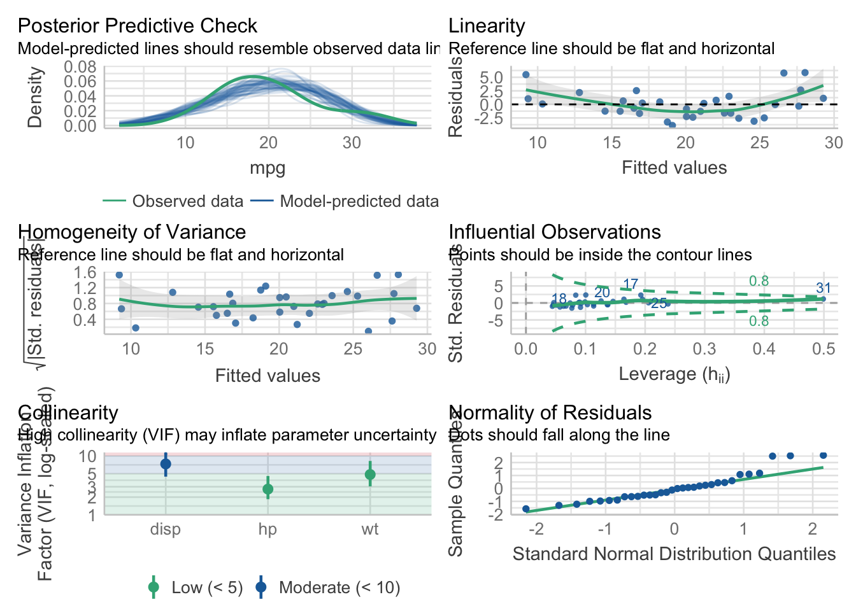

Slide 25
Logistic regression
Review based on: https://statsandr.com/blog/binary-logistic-regression-in-r/

Slide 26
Logistic regression
Regression: model the relationship between two or more variables
Estimate the relationship between a qualitative dependent variable (outcome) and one or more independent variables (predictor) of any type
Binary logistic regression: estimate the relationship between a binary dependent variable (two outcomes) and one or more independent variables of any type
dependent variable (outcome)
independent variable (predictor)
Image: https://medium.com/@praveenraj.gowd

Slide 27
Binary logistic regression
Binary variable (dichotomous) is special case of qualitative variable with only two categories
Relevant to disease outcome modeling where cases (1) and controls (0) are coded as binary outcomes
Multivariable binary logistic regression is used when the goal is to estimate the relationship between a binary dependent variable (outcome) and two or more independent variables (predictors) of any type

Slide 28
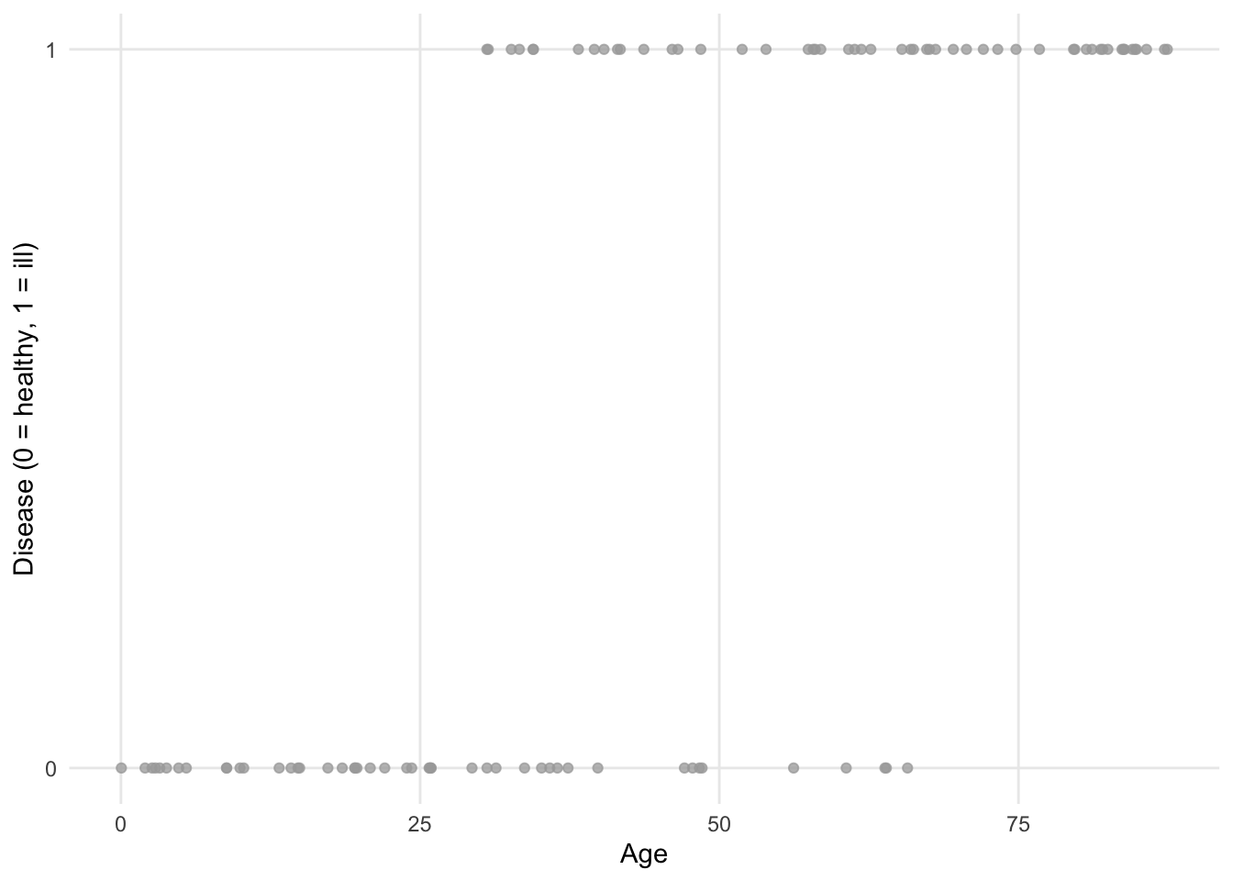
Simple logistic regression: basic idea
Example: estimating the impact of age on whether or not a participant has a certain disease. Age is continuous, disease is binary.
library(kmed)
dat <- heart

Slide 29
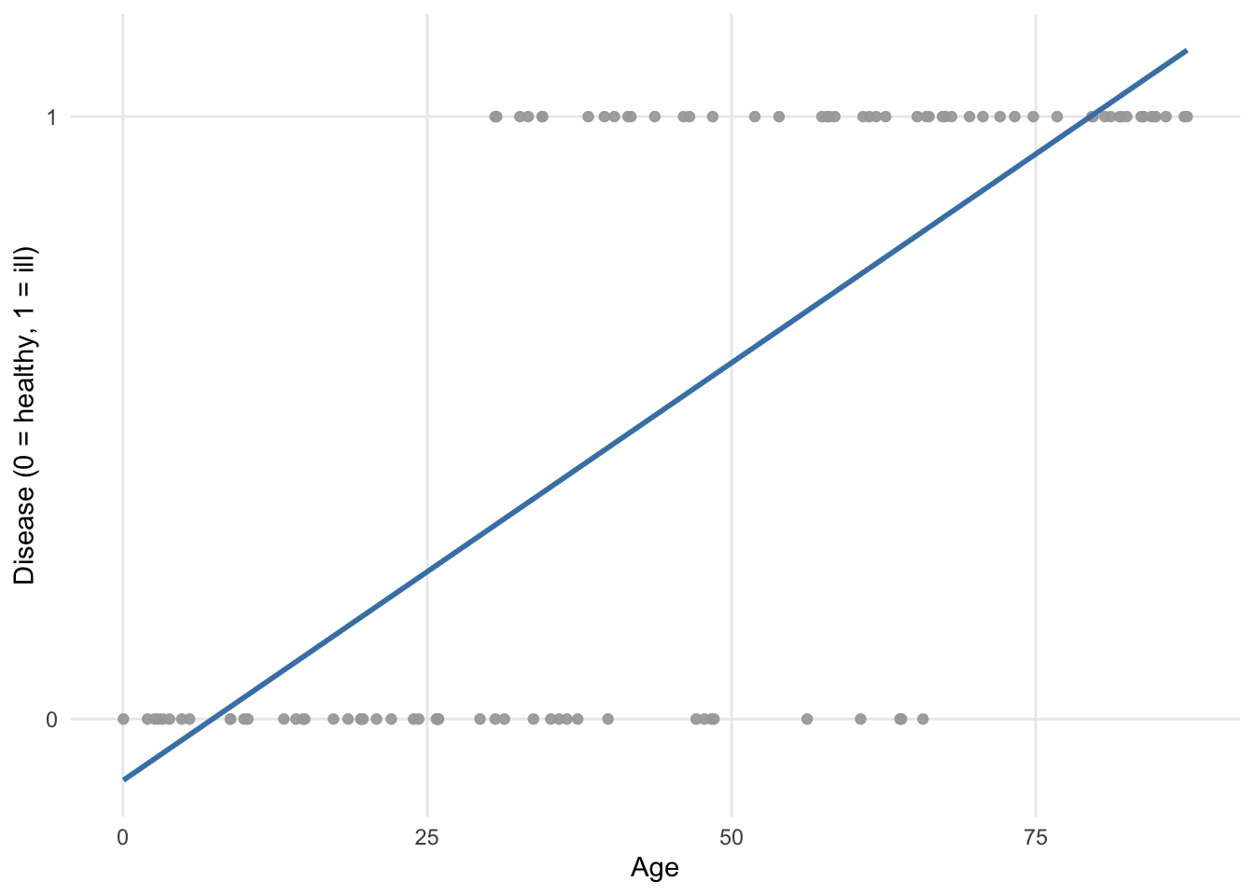
Simple logistic regression: basic idea
This plot is obtained if a regression line is fit using ordinary least squares.
Regression line goes below 0 and above 1, which doesn’t make sense for these data.
Also, assumptions of normality and homoscedasticity are violated.
https://statsandr.com/blog/binary-logistic-regression-in-r/

Slide 30
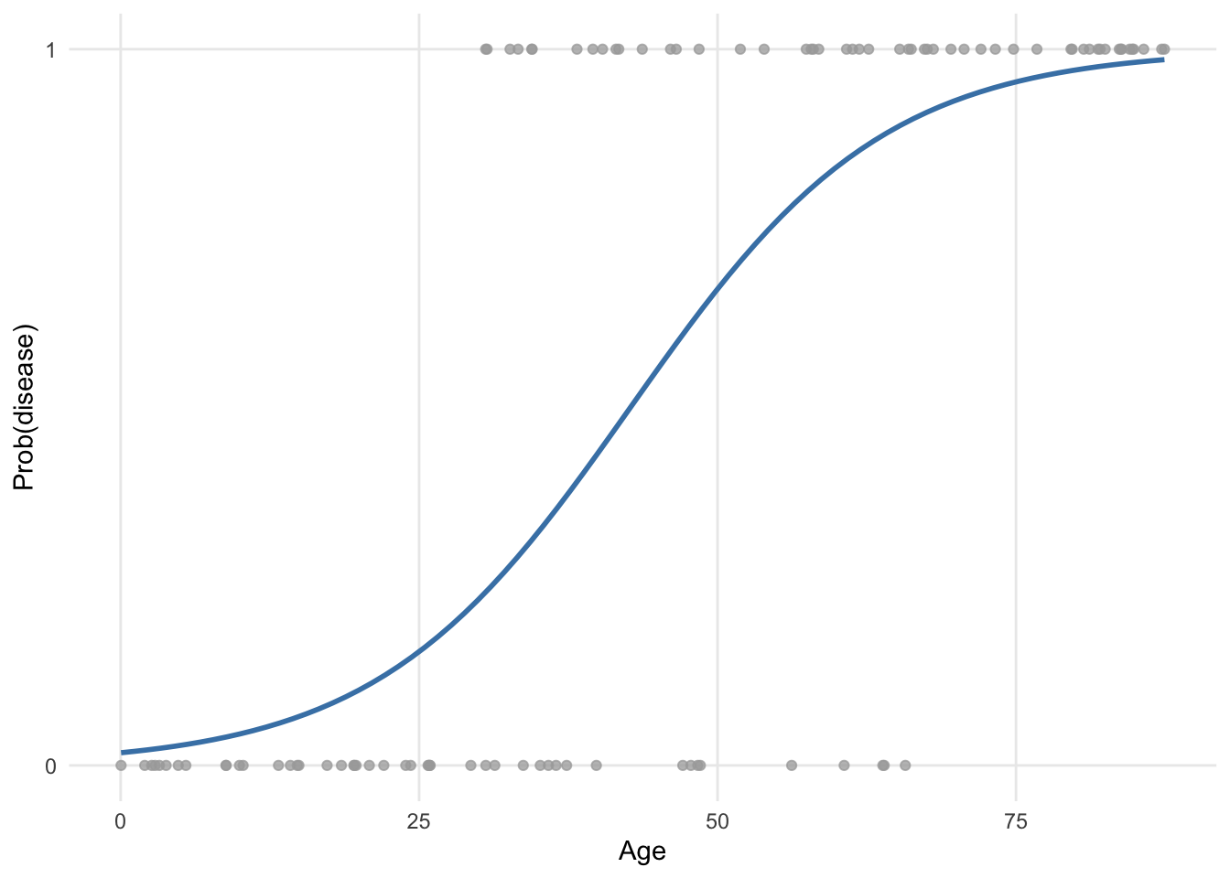
Simple logistic regression: basic idea
This is how points are fitted using binary logistic regression. More appropriate.
Sigmoid curve is obtained via transformation of predicted values.
Uses a ‘link function’ that constrains predicted values to be within range of observed values.
Logit function relates probability of disease to linear combination of independent variables.

Slide 31
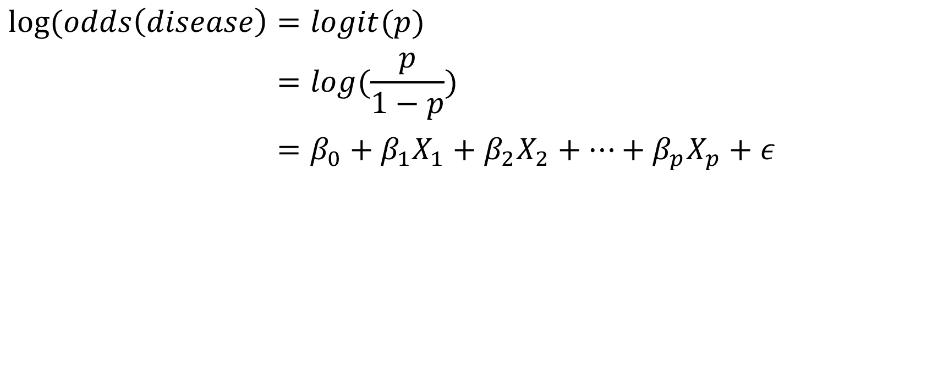
Logit function
$$log⁡(odds\left(disease\right)=logit(p)$$
$$log⁡(odds\left(disease\right)=log(\frac{p}{1−p})$$
$$log⁡(odds\left(disease\right)=β_{0}+β_{1}X_{1}+β_{2}X_{2}+…+β_{p}X_{p}+ε$$
*Note that logistic regression is a generalization of ordinary linear regression using the logit link function

Slide 32
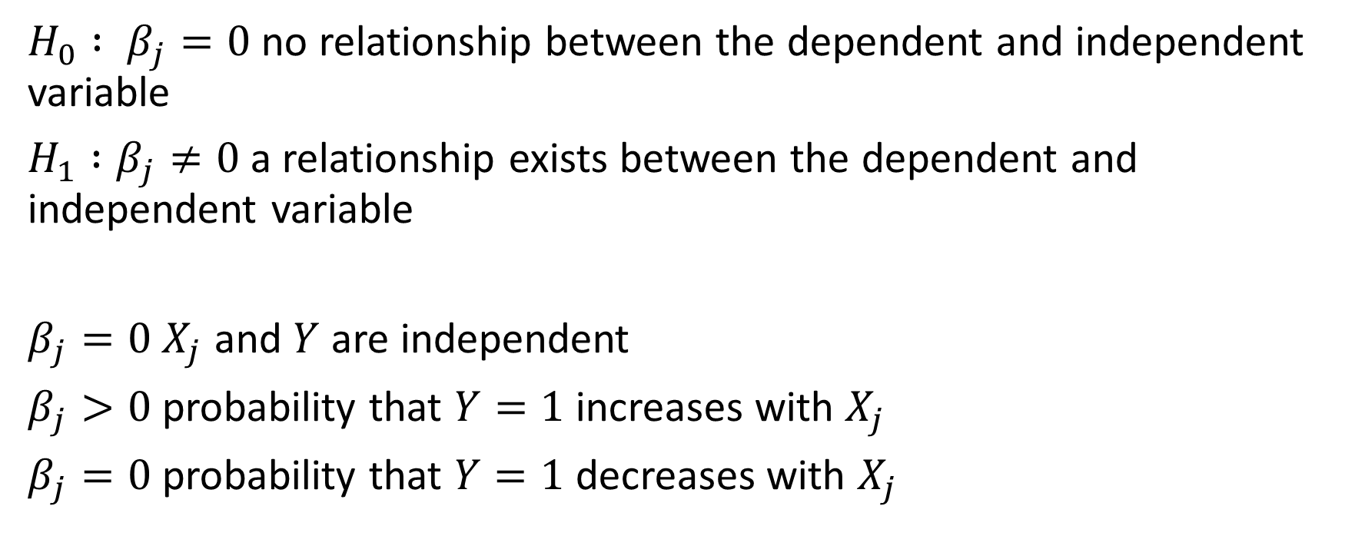
Logistic regression interpretation
$H_{0} : β_{j}=0$ no relationship between the dependent and independent variable
$H_{1} :β_{j}≠0$ a relationship exists between the dependent and independent variable
$β_{j}=0$ $X_{j}$ and $Y$ are independent
$β_{j}>0$ probability that $Y=1$increases with $X_{j}$
$β_{j}=0$ probability that $Y=1$decreases with $X_{j}$

Slide 33
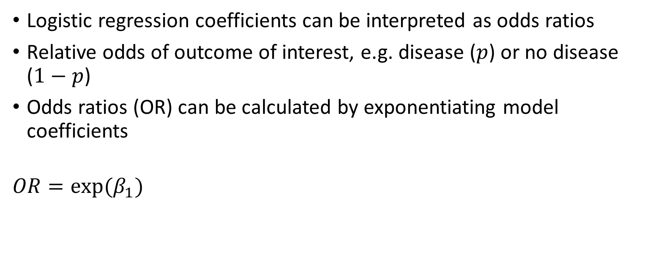
Logistic regression interpretation
Logistic regression coefficients can be interpreted as odds ratios
Relative odds of outcome of interest, e.g. disease ($p$) or no disease ($1−p$)
Odds ratios (OR) can be calculated by exponentiating model coefficients
$$OR=exp⁡(β_{1})$$

Slide 34
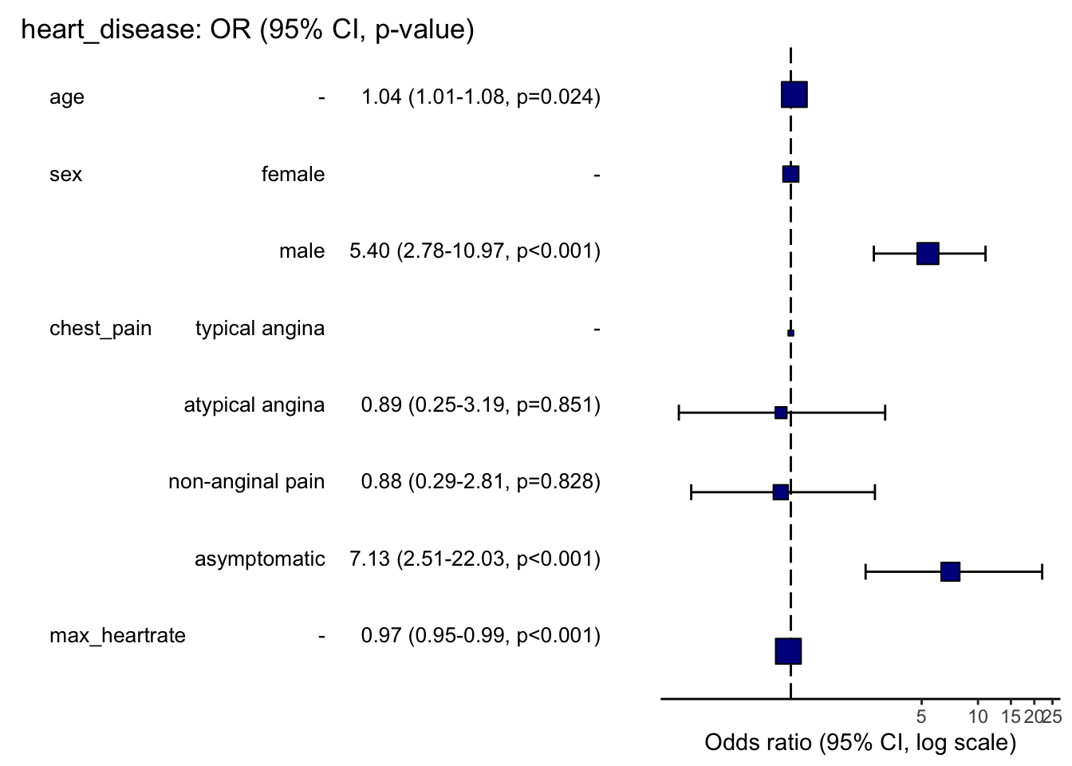
Logistic regression interpretation (forest plot)

Slide 35
Application to health disparities

Slide 36
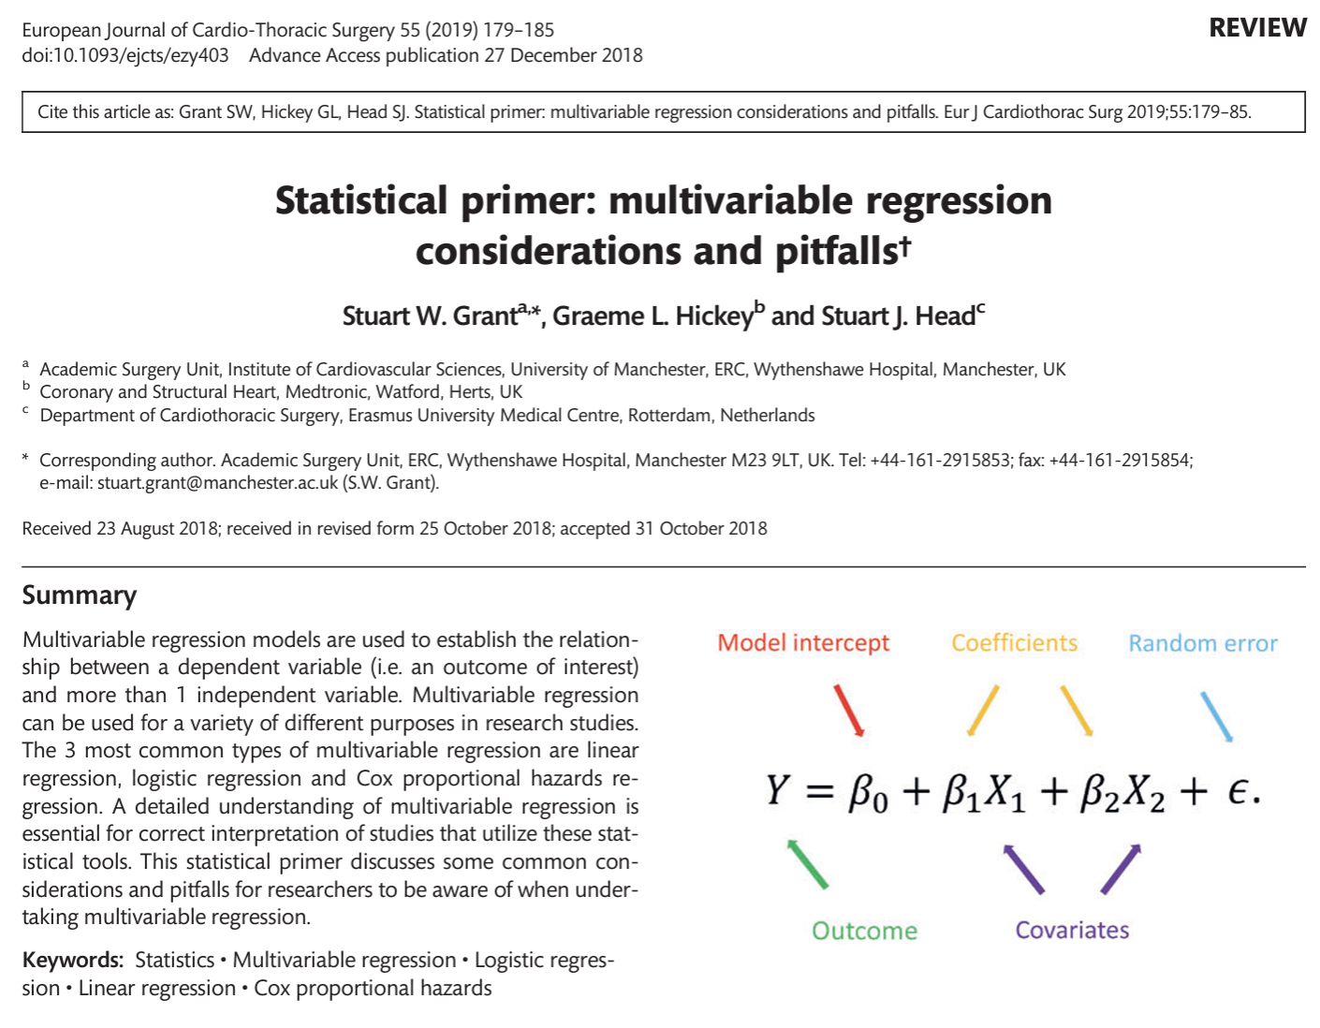

Slide 37
Regression study design
We have discussed how regression works
Study design is equally if not more important
First step is model specification – figuring out which independent variables should be included in your health outcome model

Slide 38
Variable selection
Ascertain which variables are going to be included in the model
Optimal way to develop a model is to specify in advance which variables will be included in the model based on expert clinical reasoning
Two things to avoid:
Prescreening – prune larger set of candidate covariates into smaller set using univariable model with significance threshold
Excluding covariates that are not significant in final model
Might exclude covariate of clinical utility and/or with effects on model (i.e. confounder)

Slide 39
Variable selection
Stepwise regression – number of covariates in model reduced
Forward selection: starting from no covariates in the model and adding in one term at a time
Backward elimination: starting from a full model with all covariates included (possibly including interaction terms) and removing 1 term at a time
Bidirectional selection (also referred to as simply ‘stepwise regression’ in some software applications): a hybrid of the forward selection and backward elimination algorithms

Slide 40
Regularized (penalized) regression
Well-suited for cases where the number of covariates is large relative to the number of observations in the data set
Model penalizes inclusion of too many covariates
Ridge regression – covariates are shrunk towards zero, thus stabilizing the covariate effects
Lasso regression – in addition to regression shrinkage, the algorithm also implements model selection by forcing some of the model coefficients to be zero
Elastic net regression – hybrid approach of both ridge and lasso regression

Slide 41
Multivariable regression for health disparities
What does this all mean for health disparities? Utility of multivariable regression
Modeling health outcomes with race/ethnicity (SIRE) and base covariates (age & sex) can tell us if we have a disparity
Significantly positive or negative coefficient for race/ethnicity term in model
Adding other potential predictors in the model can tell us if the effect of race/ethnicity on the health outcome of interest is attenuated – meaning that these risk factors ‘explain’ the disparity (to some extent)
Social determinants of health (SDOH)
Genetic ancestry (GA)

Slide 42
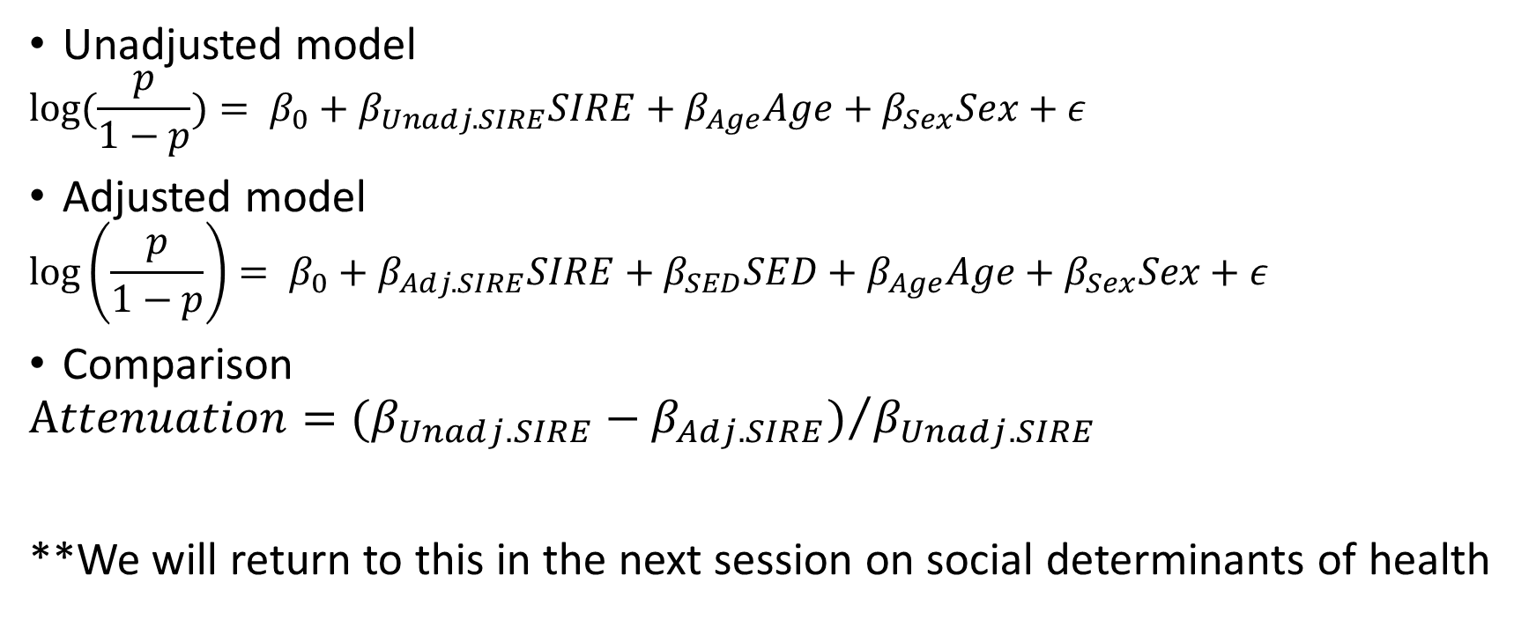
Multivariable regression for health disparities
Unadjusted model
$$log⁡(\frac{p}{1−p})= β_{0}+β_{Unadj.SIRE}SIRE+β_{Age}Age+β_{Sex}Sex+ε$$
Adjusted model
$$\log\left(\frac{p}{1−p}\right)= β_{0}+β_{Adj.SIRE}SIRE+β_{SED}SED+β_{Age}Age+β_{Sex}Sex+ε$$
Comparison
$$Attenuation={(β_{Unadj.SIRE}−β_{Adj.SIRE})}/{β_{Unadj.SIRE}}$$
**We will return to this in the next session on social determinants of health

Slide 43
Examples

Slide 44
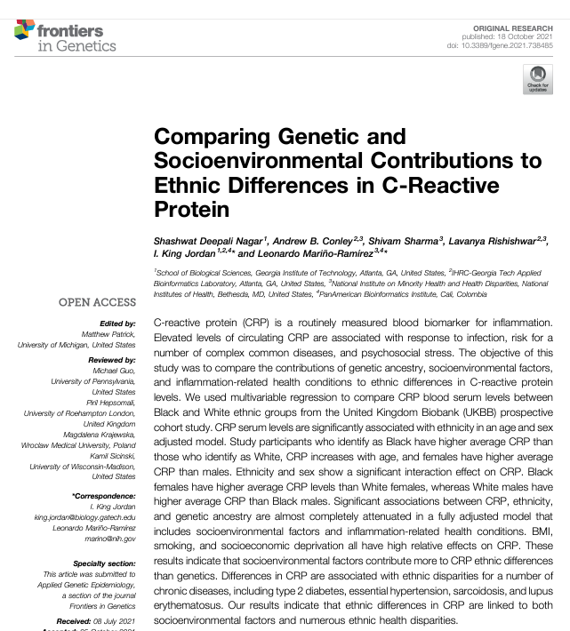




Shashwat
Nagar
Andy Conley
Shivam Sharma
Lava Rishishwar

Slide 45
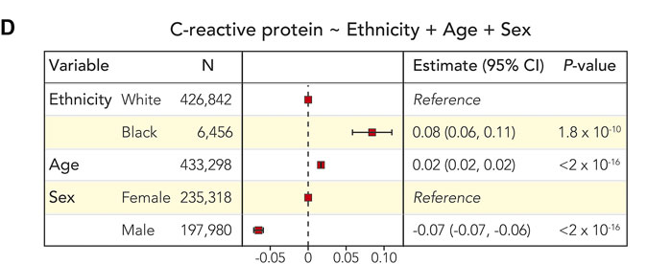
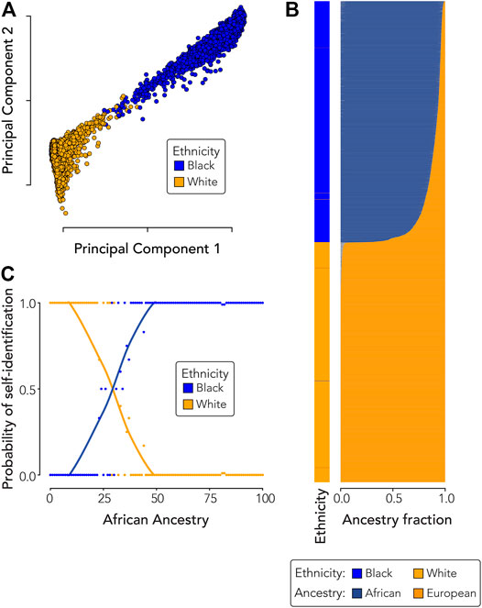
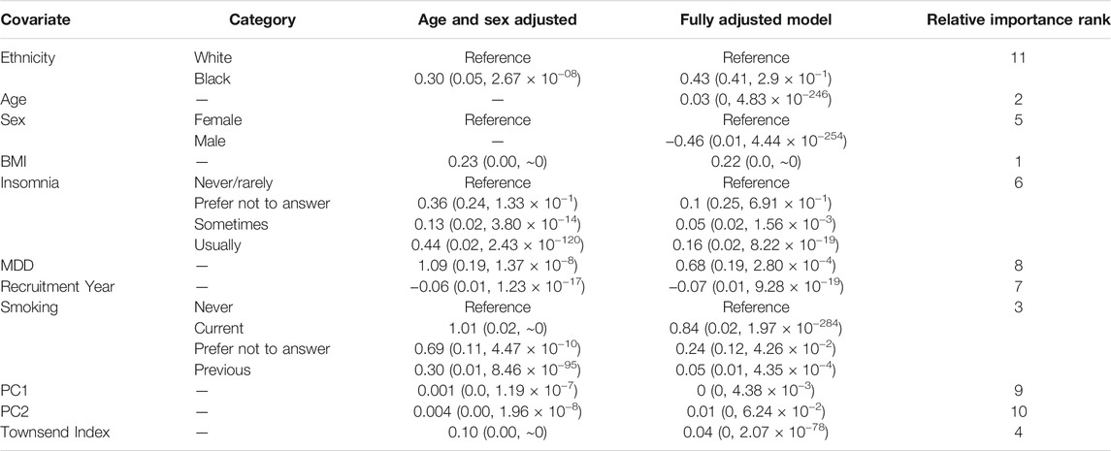
Genetic ancestry & C-reactive protein
socioenvironmental factors contribute more than genetics

Slide 46
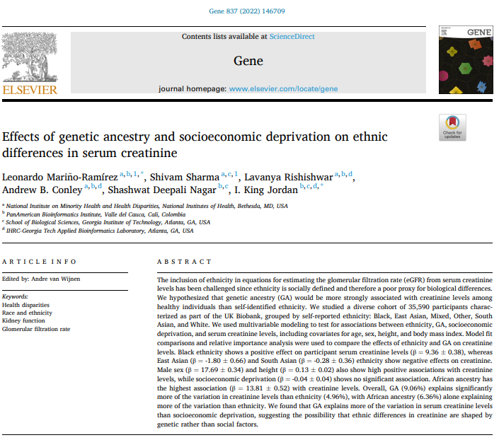
Shivam Sharma
Lava Rishishwar
Shashwat
Nagar
Andy Conley

Slide 47
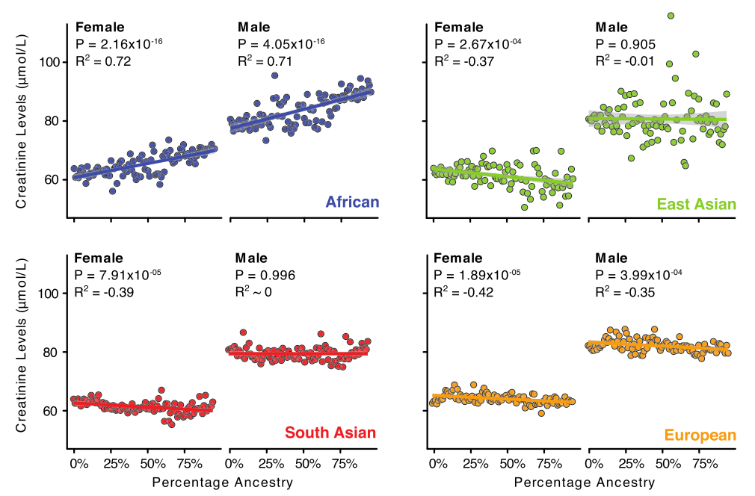
Genetic ancestry & creatinine

Slide 48
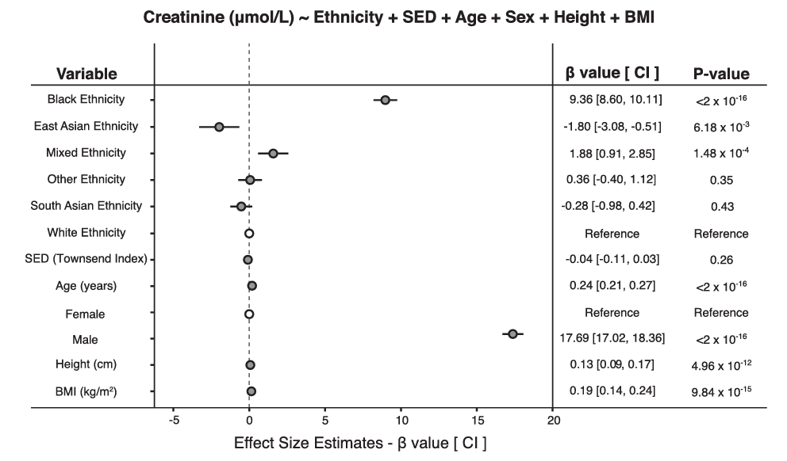
Genetic ancestry & creatinine
*no effect of social environment

Slide 49
Questions for the practical lab session
How can the effects of race/ethnicity on continuous and binary health outcomes be quantified using:
Multivariable linear regression?
Multivariable logistic regression?
How are these effects interpreted?
How are these effects visualized?

Slide 50
Ethics

Slide 51
Ethics continued … group differences versus individual-level characteristics
Reasons to be careful, thoughtful, and sensitive:
Focus on socially disadvantaged minority groups
Focus on group differences
What (if anything) do group differences tell us about individual-level characteristics
*It’s a paradox!
**It depends

Slide 52
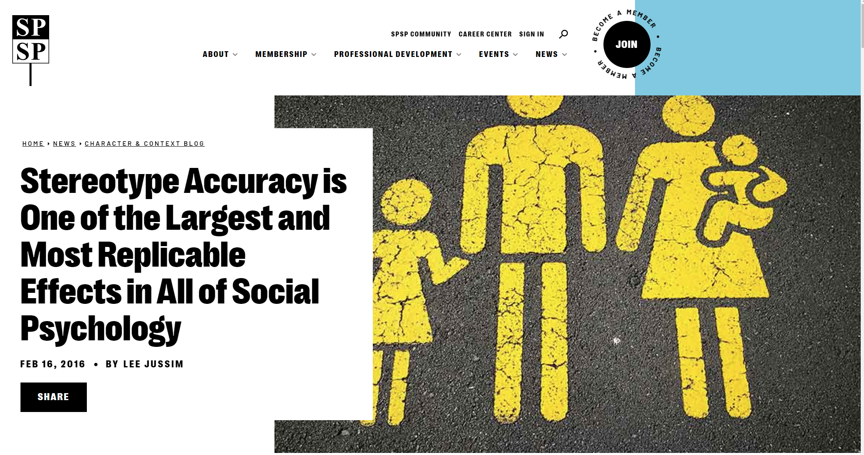
https://spsp.org/news-center/character-context-blog/stereotype-accuracy-one-largest-and-most-replicable-effects-all
https://www.psychologytoday.com/us/blog/insight-therapy/201809/stereotype-accuracy-displeasing-truth

Slide 53
Stereotype accuracy & individuating information
Stereotypes are beliefs about groups of people – can be positive or negative
Health disparities can be considered as a kind of “stereotype” – since they are group differences
Widely considered to be harmful – can give rise to prejudices and facilitate intergroup hostility
Over 50 studies (as of 2016) support the accuracy of demographic, national, political, and other stereotypes
One of the largest and most replicable effects in all of social psychology (r>0.5 compared to typical r=0.05)
https://spsp.org/news-center/character-context-blog/stereotype-accuracy-one-largest-and-most-replicable-effects-all
https://www.psychologytoday.com/us/blog/insight-therapy/201809/stereotype-accuracy-displeasing-truth

Slide 54
Stereotype accuracy & individuating information
Stereotypes influence perception when individuating information is absent or ambiguous
When individuating information is clear and relevant, its effects are “massive” and stereotype effects tend to be weak or nonexistent
https://spsp.org/news-center/character-context-blog/stereotype-accuracy-one-largest-and-most-replicable-effects-all
https://www.psychologytoday.com/us/blog/insight-therapy/201809/stereotype-accuracy-displeasing-truth

Slide 55
The paradox of group differences versus individual-level characteristics
How can group differences be simultaneously real and (essentially) irrelevant to individual-level characteristics?

Slide 56
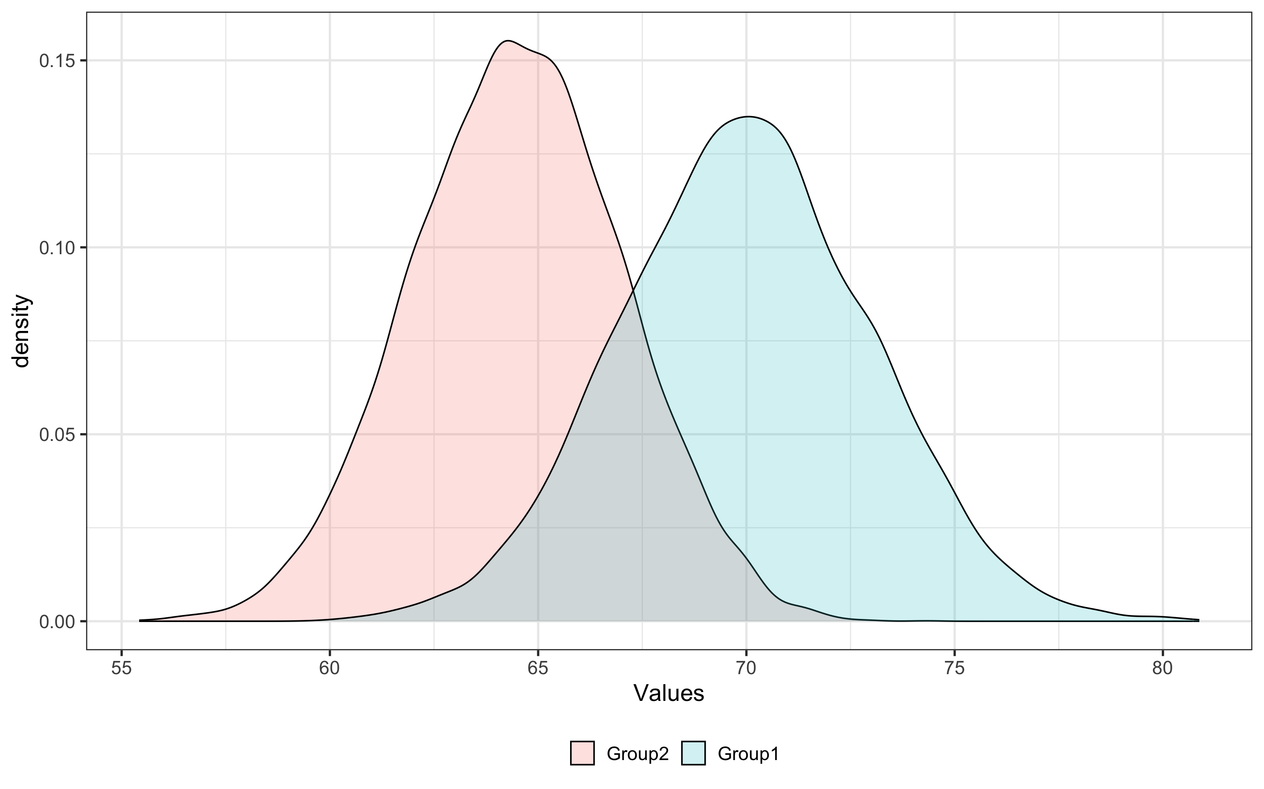
An example of group differences versus individual-level characteristics
Mean Stdev
Group1 69.98 3.00
Group2 64.50 2.53

Slide 57
An example of group differences versus individual-level characteristics
Welch Two Sample t-test
data: Values by Distribution
t = 139.79, df = 19441, p-value < 2.2e-16
alternative hypothesis: true difference in means between group Group1 and group Group2 is not equal to 0
Call:
lm(formula = Values ~ Distribution, data = dataset)
Residuals:
Min 1Q Median 3Q Max
-10.2705 -1.8595 -0.0054 1.8405 10.8957
Coefficients:
Estimate Std. Error t value Pr(>|t|)
(Intercept) 64.49875 0.02772 2327.0 <2e-16 ***
Group1 5.47970 0.03920 139.8 <2e-16 ***
---
Signif. codes: 0 ‘***’ 0.001 ‘**’ 0.01 ‘*’ 0.05 ‘.’ 0.1 ‘ ’ 1
Residual standard error: 2.772 on 19998 degrees of freedom
Multiple R-squared: 0.4942, Adjusted R-squared: 0.4942
F-statistic: 1.954e+04 on 1 and 19998 DF, p-value: < 2.2e-16

Slide 58
The paradox of group differences versus individual-level characteristics
These groups are different – large effect size(s) & highly significant
How well can group identity predict individual characteristics?
The expected value for each group is the mean value for that group

Slide 59
An example of group differences versus individual-level characteristics
31%
27%
These data are for height, with separate female and male group distributions
If you use group identity (i.e. sex) to predict height, you will guess correctly to within +/- 1 inch 31% of the time for females and 27% of the time for males
You will guess wrong 69% of the time for females and 73% of the time for males!
If you want to know someone’s height, measure it directly
+/- 1 inch
+/- 1 inch
Mean Stdev
Male 69.98 3.00
Female 64.50 2.53
Height in inches
Female
Male

Slide 60
Relevance of group differences to disease stratification: liability threshold model
25%
10%
5%
1%
Liability threshold model: individual is considered to be a disease case if their underlying liability, measured on a continuous scale, is above a threshold
Threshold | Cutoff | % Male | % Female
Top 1% | >76.2 | 100 | 0
Top 5% | >73.8 | 99.9 | 0.1
Top 10% | >72.5 | 99.8 | 0.2
Top 25% | >70.1 | 97.7 | 2.3
Disease Liability Scale
Female
Male

